Slide 1
Object Oriented Programming
Lecture-03
Class and Object

Slide 2
Lecture Outline
A Simple Class
C++ Objects as Physical Objects
C++ Objects as Data Types

Slide 3
Class and Object Concept
Everything in C++ is associated with classes and objects, along with its attributes and methods.
For example: in real life, a car is an object. The car has attributes, such as weight and color, and methods, such as drive and brake.
Attributes and methods are basically variables and functions that belongs to the class. These are often referred to as "class members".

Slide 4
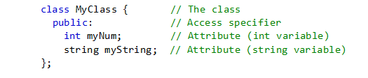
Create a Class
Create a Class
To create a class, use the class keyword.
For example create a class classes Myclass:

Slide 5
Example Explained
The class keyword is used to create a class called MyClass.
The public keyword is an access specifier, which specifies that members (attributes and methods) of the class are accessible from outside the class. You will learn more about access specifiers later.
Inside the class, there is an integer variable myNum and a string variable myString. When variables are declared within a class, they are called attributes.
At last, end the class definition with a semicolon ;.

Slide 6
Create an Object
In C++, an object is created from a class. We have already created the class named MyClass, so now we can use this to create objects.
To create an object of MyClass, specify the class name, followed by the object name.
To access the class attributes (myNum and myString), use the dot syntax (.) on the object:

Slide 7
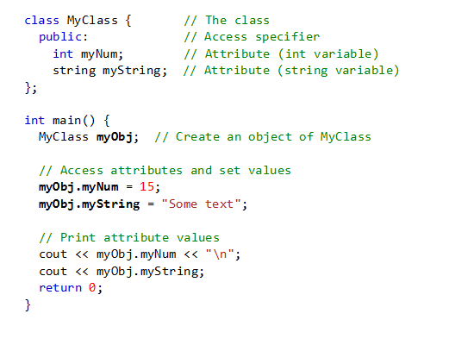

Slide 8
Data Member
The data items or data Attributes within a class are called data members (or sometimes member data).
There can be any number of data members in a class, just as there can be any number of data items in a structure. The data member some data follows the keyword private, so it can be accessed from within the class, but not from outside.

Slide 9
Member Functions
Member functions are functions that are included within a class, also known as methods.

Slide 10
Functions Are Public, Data Is Private
Usually the data within a class is private and the functions are public. This is a result of the way classes are used.
The data is hidden so it will be safe from accidental manipulation, while the functions that operate on the data are public so they can be accessed from outside the class.
However, there is no rule that says data must be private and functions public; in some circumstances you may find you’ll need to use private functions and public data.

Slide 11
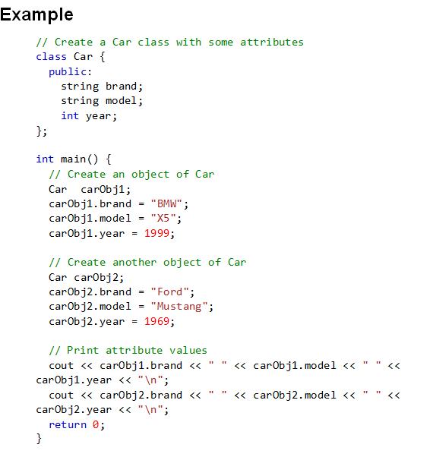
Multiple Objects

Slide 12
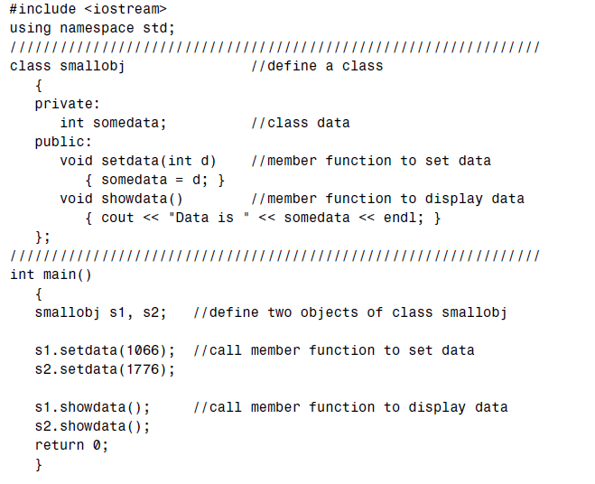
Example Program 2

Slide 13
Explanation
The class smallobj defined in this program contains one data item and two member functions.
The two member functions provide the only access to the data item from outside the class.
The first member function sets the data item to a value, and the second displays the value.

Slide 14
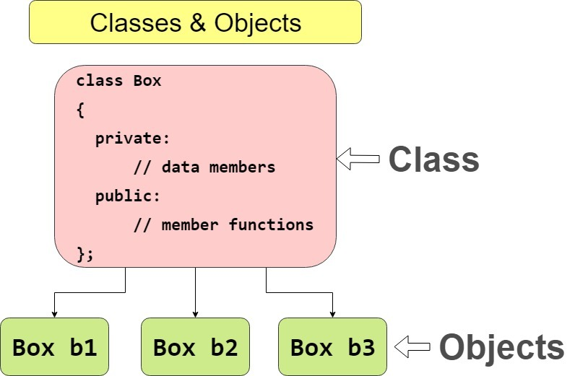
Class and Object Concept

Slide 15
Class Activity
Write a C++ code to display student information for 3 students(name, Reg_No, Department, CGPA and Current Semester and list of registered Courses) using class and object.
Set_value() function to get user input for each student.
Print_value() function to print the record for each user.

